Slide 1
DEPARTMENT OF CSE
COURSE NAME – Cloud devops
Cohort-5
22CEC3204
Topic:
Linux Fundamentals
Notes:
Good Day All,
I am Anjana.
In this lecture,I am going to give an Overview on Docker from Continuous Delivery and Devops.

Slide 2
Linux commands
Operating System Concept
Brief History of UNIX & Linux
A Linux Distribution
Architecture of Linux
Basic Principals of Linux
Linux File System
Typical Linux Directory Structure
How to login
Basic Linux Commands

Slide 3
Operating System Concept
An operating system (OS) is a resource manager
It is a set of software routines:
  that allow users and application programs to access system resources
  in a safe, efficient and abstract way
  CPU, memory, disks, modems, printers network cards etc.
A general operating system architecture can be understood by the figure
Users
Shell or GUI
Application Programs | System Utilities
System Call Library
Operating System Kernel
Dual Processor with 2 GB RAM, 160 GB Hard Disk

Slide 4
Operating System Concept
The kernel controls the hardware
It provides functions like
  Handling of interrupts from the devices
  Allocation of memory to programs
  Sharing of CPU among the programs
Basic kernel services are exposed to higher-level programs through a library of system calls
Application Programs and System Utility Programs make use of system calls
  Launched using a shell/GUI
The OS may differ from one another on the basis of:
  System calls
  System utilities
  User interface they provide
  Resource scheduling policies implemented by the kernel

Slide 5
History of UNIX & Linux
In late 1960s, MULTICS was introduced for mainframe computers
Joint venture of GE, MIT and Bell Labs
Inspired Ken Thompson – who wrote simpler version called UNICS, which evolved into UNIX
Ken Thompson with Dennis Ritchie in 1973 wrote the UNIX kernel in C
The Fifth edition of UNIX was released to universities in 1974
In 1978, UNIX development was split into two main branches:
  SYSV
  BSD

Slide 6
History of UNIX & Linux
Linux – open source OS for PCs
Developed by Linus Torvalds (a Finnish graduate student), in 1991
Neither pure SYSV nor BSD, mix of both
Conforms to a set of standards called POSIX
Code freely available, anyone can:
  Modify, add features, correct deficiencies
Different Distributions:
  Caldera Systems Corel Debian Mandrake
  Red Hat Slackware Strom SUSE
  Turbo Gentoo Stampede Knoppix
  Fedora Ubuntu College Linux White Box Linux

Slide 7
A Linux Distribution
A distribution comprises of:
  Kernel
    2.6.9-89.0.11.EL.cernsmp
  System Utilities
    File copy, hard disk repair/defragment etc.
  GUI
    GNOME, KDE
  Application Programs
    Open office, evolution, firefox, gedit, gftp. konqueror, evince, kdevelop, kview, emace, vim etc.

Slide 8
Architecture of Linux
Kernel
  Initializes the device drivers
  Processor & memory management functions
  Support for many different type of file systems
  A wide range of system calls (mix of SYS V, BSD and POSIX.1)
  Loaded into the memory at system startup
  Location /boot/vmlinuz
  Source files /usr/src/linux
Shells & GUIs
  Textual command line shells
    bourne shell (sh), bourne again shell (bash)
    csh and tcsh
  GUI Environment
    GNOME and KDE

Slide 9
Architecture of Linux
System Utilities
  ls, grep, sed, awk, less, bc, wc, more etc.
  Powerful tools that perform a single task extremely well
  Can also chain programs together using pipes
  Server programs called daemons
Application Programs
  emacs, vi, kdevelop, gcc, g++, open/star office etc.

Slide 10
Basic Principals of Linux
Everything is a file
Small, single purpose programs
Ability to chain programs to perform complex tasks
Avoid captive user interface
Configuration data is stored in text
Linux is case-sensitive

Slide 11
Linux File System
Every file in Linux can be one of the following four types:
  Ordinary File (contain data, info)
  Directories (hold files & other directories)
  Devices (for accessing the hardware)
  Links (Pointer to another file)
    Hard Link
    Soft Link

Slide 12
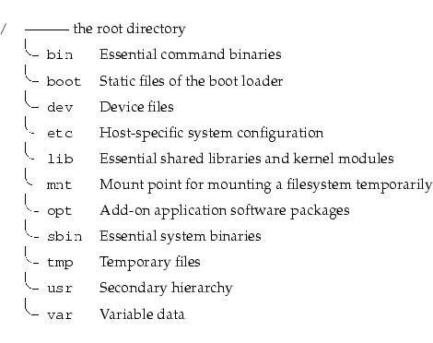
Typical Directory Structure
Linux Filesystem is laid out in a hierarchical tree structure.
Top level directory is called root “/”

Slide 13
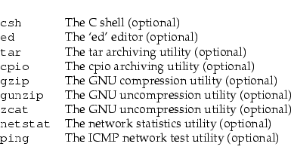
/bin: Binary files
/bin contains commands that may be used by both the system administrator and by users

Slide 14
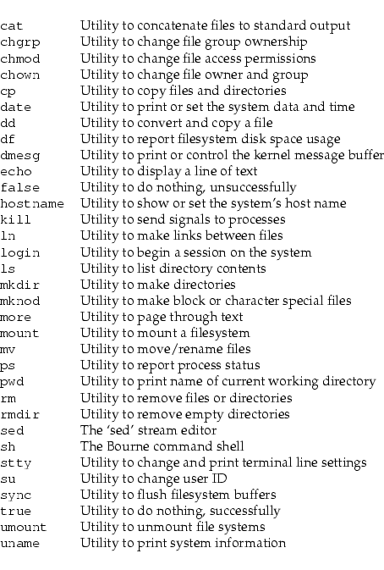
/bin: Binary files

Slide 15
/sbin: Super-user Binaries
This directory contains the binaries used by the root user
/boot: Boot files
This directory contains everything required for the boot process except configuration files

Slide 16
/dev : Device files
The /dev directory is the location of special or device files
/proc : Virtual File System
The /proc directory contains directories and files that report system information and status

Slide 17
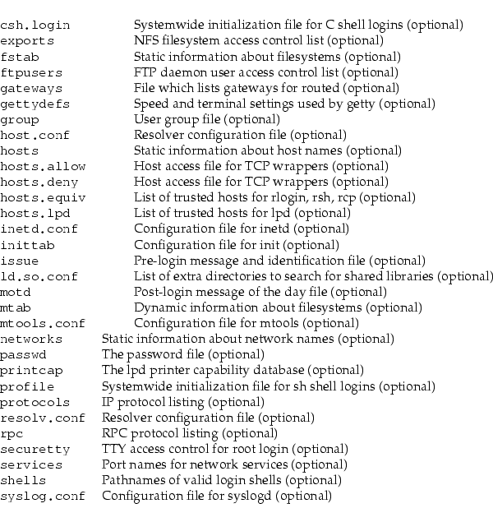
/etc: Configuration files
/etc contains configuration files and directories.

Slide 18
/home: User area
/home contains user home directories
Area writable by individual users
Others users may be able to read depending upon permissions

Slide 19
/lib: Library files
/lib contains essential shared libraries and kernel modules.
The /lib directory contains those shared library images needed to boot the system and run the commands in the root filesystem, i.e., by binaries in /bin and /sbin.

Slide 20
/mnt: Mount area
Mount point for a temporarily mounted filesystem.
This directory is provided so that the system administrator may temporarily mount a filesystem as needed.
The content of this directory is a local issue and should not affect the manner in which any program is run.

Slide 21
/root & /tmp
The /root is a home directory for the root user
The /tmp directory must be made available for programs that require temporary files
/tmp is writable by everyone i.e. world writable

Slide 22
/usr/lib: Library files
Libraries for programming and packages.
/usr/lib includes object files, libraries, and internal binaries that are not intended to be executed directly by users or shell scripts.

Slide 23
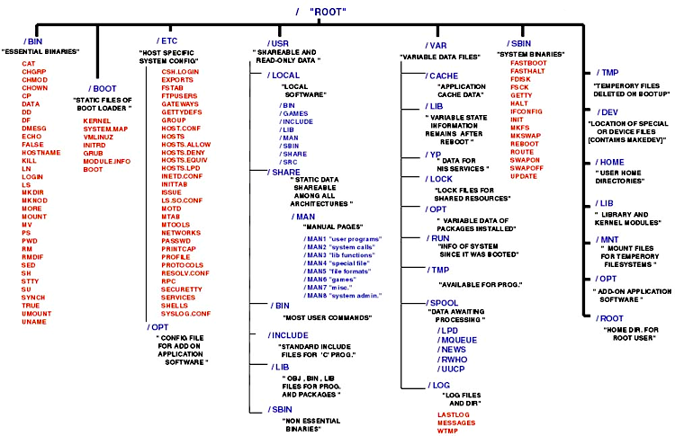

Slide 24
Summary: Directory Structure
Home Directories: /root,/home/username
User Executables: /bin, /usr/bin, /usr/local/bin
System Executables: /sbin, /usr/sbin, /usr/local/sbin
Other Mountpoints: /media, /mnt
Configuration: /etc
Temporary Files: /tmp
Kernels and Bootloader: /boot
Server Data: /var, /srv
System Information: /proc, /sys
Shared Libraries: /lib, /usr/lib, /usr/local/lib

Slide 25
Logging into a Linux System
Two types of login screens
  virtual consoles (text-based)
  graphical logins (display managers)
Login using login name and password
Each user has a home directory for personal file storage

Slide 26
Absolute & Relative Paths
Absolute pathnames
  Begin with a forward slash
  Complete "road map" to file location
  Can be used anytime you wish to specify a file name
Relative pathnames
  Do not begin with a slash
  Specify location relative to your current working directory
  Can be used as a shorter way to specify a file name

Slide 27
Basic Linux Commands
ls, listing files and directories
  ls –a
  ls –l
  ls –C
  ls –F
  ls --color
  ls –d
  ls –g
  ls –o
  ls –h
  ls –lh, ls –CaF

Slide 28
Basic Linux Commands
cd, change directory
  cd ..
  cd –
  cd ~/mydir
  cd /home/usman
  cd
su, switch user, su – (complete user environment)
id, print user and group ids
passwd, change password
  yppasswd

Slide 29
Basic Linux Commands
man, manual pages
  man <command>
info, information pages
  info <command>
command --help, basic help by author
  ls --help, man --help
pwd, present working directory

Slide 30
Basic Linux Commands
ps, process information
  ps aux
  pstree
  ps fax
  top
free, memory information
  free –m
cal, calendar information
  cal, cal 2009
head, output the first part of files
  head [-n <lines>] <filename>
tail, output the last part of files
  tail [-n <lines>] <filename>

Slide 31
Basic Linux Commands
cat, concatenate/display files
  cat /home/usman/myfile
clear, clears the screen
date, see/modify system date & time
  date, date [MMDDhhmm[[CC]YY][.ss]]
df, disk space usage
  df –h
du, file space usage
  du –sh
uname, print system info
  uname [-a, -s, -n, -r, -v, -m]

Slide 32
Basic Linux Commands
echo, display a line or text
  echo “any text”, echo $HOSTNAME
exit, exit the current session/shell
file, determine file type
  file <file name/path>
hostname, show or set the system hostname
  hostname [<new-name>]
more, file perusal filter for CRT viewing
  more <file name/path>
less, file perusal filter
  less <file name/path>

Slide 33
Basic Linux Commands
cp, copy files and directories
  cp [options] file destination
More than one file may be copied at a time if the destination is a directory:
  cp [options] file1 file2 destination
If the destination is a directory, the copy is placed there
If the destination is a file, the copy overwrites the destination
If the destination does not exist, the copy is renamed

Slide 34
Basic Linux Commands
mv, move and/or rename files and directories
  mv [options] file destination
More than one file may be moved at a time if the destination is a directory:
  mv [options] file1 file2 destination
In mv also, the destination works like cp
mkdir, creates directories
  mkdir <directory name/path>
rmdir, removes empty directories
  rmdir < directory name/path>

Slide 35
Basic Linux Commands
touch, create empty files or update file timestamps
  touch <file name/path>
rm, remove files
  rm [options] <file name/path>
  rm -i file (interactive)
  rm -r directory (recursive)
  rm -f file (force)
rm –r, recursively removes directory trees
  rm –rf <directory name/path>

Slide 36
Basic Linux Commands
chsh, change your login shell
alias, setting command aliases
  alias ll=‘ls –l’
whoami, print user id
find, finding files and directories
  find <path> –iname <file name>
  find <path> -size +100
  find <path> -user usman –o –group it
  find <path> -perm 755

Slide 37
File Permissions in Linux
Octal | Binary | Permissions
0 | 000 | _ _ _
1 | 001 | _ _ x
2 | 010 | _ w _
3 | 011 | _ w x
4 | 100 | r _ _
5 | 101 | r _ x
6 | 110 | r w _
7 | 111 | r w x

Slide 38
Basic Linux Commands
chmod, changing permissions of files/directories
  Octal mode
    chmod 644 <file name/path>
    chmod 755 <file name/path>
    chmod 6 <file name/path>
  Symbolic mode
    chmod u+x, g-r, o+x <file name/path>
    chmod a+x <file name/path>
    chmod =x <file name/path>
chown, changing ownership of files/directories
chgrp, changing group ownership of files/directories
  chown usman <file name>
  chgrp it <file name>
  chown usman.it <file name>

Slide 39
Basic Linux Commands
stat, display the file status
  stat <file name/path>
ssh, Open SSH client for remote login
  ssh <username>@<hostname>
  ssh –l <username> <hostname>
  ssh <hostname>
scp, secure copy (remote file copy)
  scp <file name> <username>@<hostname>:<path>
  scp <username>@<hostname>:<path> <local path>

Slide 40
Basic Linux Commands
env/setenv, adding or changing a variable
Setting variable values
  MYVAR=“something”
  echo $MYVAR
  bash shell
    export MYVAR=“something”
  tcsh shell
    setenv MYVAR “soemthing”
Sourcing files
  source /home/env/my_env.csh
  . /home/env/my_env.sh

Slide 41
Basic Linux Commands
ln, creating links
  ln <source file name/path> <link name>
  ln –s <source file name/path> <link name>
.bashrc (bash shell)
  For setting local variables and aliases
.tcshrc (tcsh shell)
  For setting local variables and aliases
.chsrc (csh shell)
  For setting local variables and aliases

Slide 42
Shell Scripting Basics
#!/bin/sh
echo “Welcome to Linux -- ” $USER
echo “Today is : ” $(date)
echo “You are working in : ” `pwd`
echo “Enter your last name: ”
read LNAME
echo "Hello -- $LNAME”
read X
read Y
echo “The product is : $X*$Y “
echo “Bye Bye…”

Slide 43
Shell Scripting Basics
#!/bin/sh
MSG=“Assignments due today…”
for i in $(cat ~/users) ; do
NAME=$i
EMAIL_ADD=$NAME@ncp.edu.pk
echo $MSG | mail –s “Warning” EMAIL_ADD
done

Slide 44
SELF-ASSESSMENT QUESTIONS
Explain the concept of partitions in Linux. How do you manage partitions?
Describe how Linux handles users and groups. What are the key files involved?

Slide 45

REFERENCES FOR FURTHER LEARNING OF THE SESSION
TEXTBOOKS:
DevOps for Web Development , Mitesh Soni, Packt Publisher.
Reference Book
Beginning DevOps With Docker , Joseph Muli , Packt Publisher.
WEB REFERNCES/MOOCS:
https://www.coursera.org/programs/cse-faculty-courses-an6zm/browse?collectionId=&productId=Q5Krn5BMEei3MQqxoqmsBA&productType=course&query=continuous+delivery+and+devops++course&showMiniModal=true&source=2

Slide 46
THANK YOU
Team – Continuous Delivery & DevOps

